Slide 1
Git & Github
Jeff Allen
Quantitative Biomedical Research Center

Slide 2
Overview
Revision Control
Git
GitHub
Documentation
Clients
Command Line
GUI
Rstudio
QBRC Proposal

Slide 3
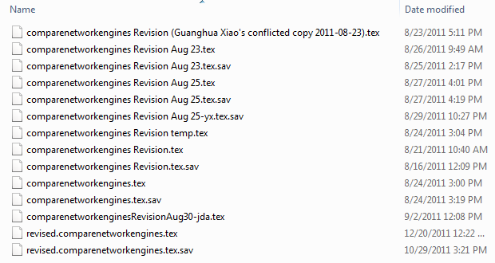
Motivation

Slide 4
Motivation

Slide 5
Motivation
A single authority on the versioning of files
Dropbox? Cluster? Email? Your laptop?
Gracefully handle conflicts
Work on the same project simultaneously
Ability to return to previous known state
Essential for large coding projects
Supports code review and collaboration

Slide 6
Terminology
“Server” – The computer storing the authoritative copy of any project.
“Repository” – The database storing all files in a project.
“Commit” – A collection of changes to file(s) in the project.

Slide 7
Terminology
“Working Copy” – The version of the project saved on your computer.
“Push” – Upload the changes made in your working copy to the server.
“Pull” – Download others’ changes from the server to your working copy.
“Clone” – The initial time you copy a project from the server.

Slide 8
Git
Modern distributed revision control system
“Distributed” means you have the entire history of the repository on your local machine.
Don’t have to be online to develop.
Makes improvements in usability and performance on past systems (Subversion).
Open-source and free.
We have a Git server hosting repositories on our cluster.

Slide 9
GitHub
A website that hosts Git repositories.
In addition to basic Git hosting…
Offers a web interface. Explore and change your project from a browser.
Unlimited public repositories
Private repos with access controls
Project organization – hosts documentation, bug tracking, etc.
Social platform – the “Facebook” of coding.
Client-Side UI

Slide 10
Github Demonstration
Notes:
Overview, list of projects
Public v Private
Show LCE Project’s files – introduce README documentation
Show commits
Show diff of a commit
Show comments/discussion on commit
Show tags
Show graphs
Show wiki – devtools - https://github.com/hadley/devtools/
Show issues
Show pull requests

Slide 11
Git Clients

Slide 12
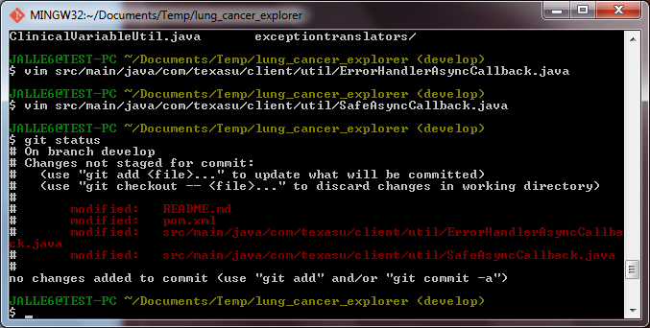
Git Clients – Command Line

Slide 13
GitHub Client - GUI
Only works with GitHub.
Much easier to use and navigate.
Mac and Windows versions.
On campus: Need to open Git Shell and run:
git config --global http.proxy http://proxy.swmed.edu:3128

Slide 14
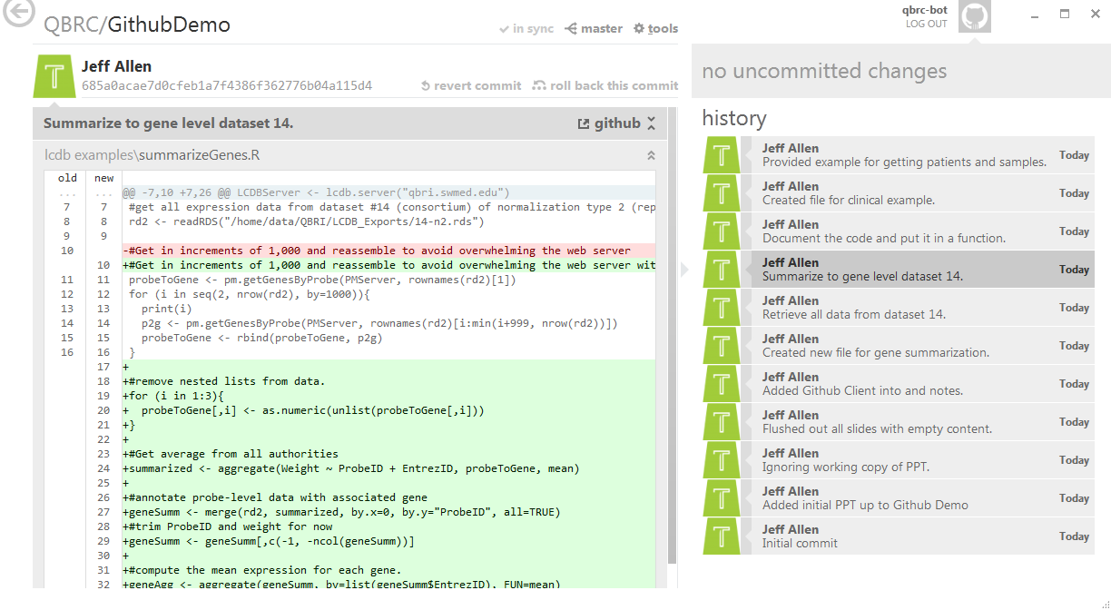
GitHub Client

Slide 15
GitHub Client Demo

Slide 16
Rstudio
Supports Git and SVN revision control for “Projects.”
Nice graphical interface for committing and viewing diffs.

Slide 17
Rstudio Demo

Slide 18
QBRC Proposal
These types of code should be on GitHub:
Anything we’ve open-sourced
Any code you want us to help you package or deploy (can be private)
But its use is encouraged in any/all coding projects
Personal repositories (SVN or Git) can be setup on the cluster for free

Slide 19
Anti-Pattern
“A pattern that may be commonly used but is ineffective and/or counterproductive in practice.”

Slide 20
Revision Control Anti-Patterns
Adding a suffix to a file to differentiate it.
Your initials, the date, version number
Attaching code to an email
Trusting that Dropbox will keep backup copies of your code
Notes:
2. Email may not always be bad (can send examples), but re-evaluate if you find yourself attaching multiple scripts to an email – will it be difficult for you or the recipient to find this code in 6 months? Should you setup a more permanent home for the code on Github?

Slide 21
Next Steps
Everyone should create a GitHub account
It’s free
Register at github.com
Send me your GitHub username and I’ll add you to our organization
Download a GitHub client:
http://windows.github.com/
http://mac.github.com/

